Slide 1


VIRTUAL INTELLIGENCE SERVICE
VICTORIA PER INTELLECTUM
HEZBOLLAH: STRUCTURE & GROUND COMBAT TACTICS
INTREP VIS-OPAR-004
DRAFT
DISCLAIMER:
This is for multiplayer online gaming using the Digital Combat Systems simulation software published by Eagle Dynamics. The information is not in any way suitable for real world use or operations.
Version: X.X
Published: YYYY-MM-DD

Slide 2
INTRODUCTION
A
A
Aim:
This document describes the structure of HEZBOLLAH’s armed forces, and how they operate
Content:
High level structure
Sectors HQs
«RADUAN» commando companies
Phases in offensive operations
B
B
C
C
D
D
E
E
F
F

Slide 3
High level structure
HEZBOLLAH’s armed forces operate as a «guerrilla-military» : combining a strict military command& Control structure with guerrilla & insurgency battle tactics.
Supreme leadership body is in direct control of four sector HQs
Supreme Leadership
Sector «WEST»
Sector «SOUTH»
Sector «EAST»
Sector «NORTH»

Slide 4
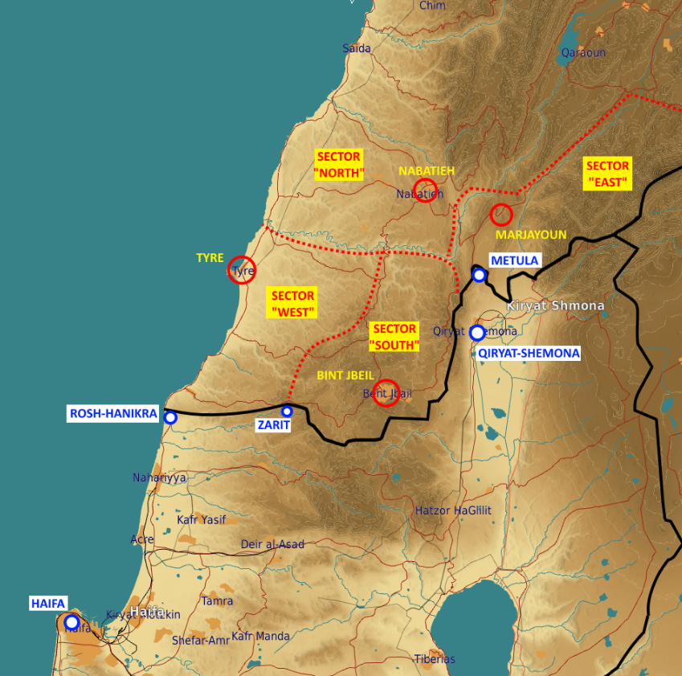
High level structure
Sector «WEST»
HQ at TYRE
Sector «SOUTH»
HQ at BINT JBEIL
Sector «EAST»
HQ at MARJAYOUN
Sector «NORTH»
HQ at NABATEIH
Holds reserves for frontline sectors
Equipped with C-802 anti-ship batteries

Slide 5
SECTOR HQ
Functions:
Control of field assets in their sectors
Sector HQ is authorized to react on Lebanon territory to any Israeli forces incursion.
Any cross-border action must be authorized by supreme leaderhip
FLOT
Front brigade #1
Special Operations Regiment
Recon Regiment
Air Defense Division
Airborne Brigade
SA-8 BN
BN
ROCKETARTY BN
Rocket Artillery Brigade
Motorized Division
Mechanized Division
Missile Brigade
BN
SECTOR HQ
“WEST” and “NORTH” sectors only
BN
BN
LOGISTIC BN
Insurgents BN
Insurgents BN
Logistics Battalion
Air Defense BN
Heavy rocket Artillery BN
Insurgents BN
Insurgents BN
Insurgents BN
Insurgents BN
Medium rocket Artillery BN
Anti-ship battery
ARTY BN
BN
«RADUAN» Company
Insurgents BN
DIV HQ
BN
BN
SA-15 BN
BN
BN
Rear brigade
Front brigade #2

Slide 6
SECTOR HQ
SECTOR HQ
“WEST” and “NORTH” sectors only
Insurgents BN
Insurgents BN
Logistics
Air Defense
Heavy rocket Artillery teams
Insurgents BN
Insurgents BN
Insurgents BN
Insurgents BN
Medium rocket Artillery teams
Anti-ship battery
«RADUAN» Company
Insurgents BN
Forces composition:
Insurgents BNs: infantry
Air defense:
SA-8s
SA-9s
SHILKA SPAAAs
ZSU-23 trucks
Heavy artillery rockets: SMERCH (x3 launchers per team)
Medium artillery rockets: BM-21 GRAD (x3 launchers per team)
Anti-ship battery:
C-802 launchers (x2)
Silkworm radar (x1)
Composition - general notes:
Unlike regular armies, HEZBOLLAH uses civilian vehicles for logistics (resupplies, troops transport and support). This makes intelligence gathering more difficult.
C2 positions are located in regular-looking houses in populated areas. Locations may be provided by higher level intelligence.

Slide 7
“RADUAN” commando compamy
Functions:
Perform quality operation against Israeli forces on the border, or against civilians by crossing the border
Seizing territories inside Israel (to be used for post-conflict negotiations from position of power)
Equipment:
Mechanized platoon: BMP-3 (x4)
Mortar artillery platoon: 2B11 Mortars (x4) + BRDM APCs for transportation
MANPAD team : STRELA missile launchers (x3)
FLOT
Front brigade #1
Special Operations Regiment
Recon Regiment
Air Defense Division
Airborne Brigade
SA-8 BN
BN
ROCKETARTY BN
«RADUAN» Company
Rocket Artillery Brigade
Motorized Division
Mechanized Division
Missile Brigade
BN
BN
LOGISTIC BN
MANPAD
Team
Mortar artillery platoon
Mechanized platoon
Infantry platoon
BN
Infantry platoon
ARTY BN
BN
DIV HQ
BN
BN
SA-15 BN
BN
BN
Rear brigade
Front brigade #2

Slide 8
PHASES IN AN OFFENSIVE OPERATION
A
A
B
B
Assembly of forces
Staging
Shaping and assault
(With indicators on each of the phases if possible)
C
C
D
D
E
E
F
F

Slide 9
PHASES IN AN OFFENSIVE OPERATION: ASSEMBLY OF FORCES
A
A
Purpose:
Recruit and assemble combatants in preparation for activity
Activity:
Gathering of troops and equipment
Briefing of troops
Preparation of combat vehicles
Assembly of transports (civ-looking) for logistics support
Duration: (24-48 hrs)
Indicators:
Possible combat vehicles IVO HEZBOLLAH HQs Increased number of trucks IVO HEZBOLLAH HQs
Most likely activity will be indicated via higher-echelon intelligence
B
B
C
C
D
D
E
E
F
F

Slide 10
PHASES IN AN OFFENSIVE OPERATION: STAGING
A
A
Purpose:
Set up forces in starting positions
Activity:
Deployment of troops and combat vehicles in starting positions (3-10km of their objectives
Duration 1-6 hours
Indicators:
Presence of insurgetns and vehicles
B
B
C
C
D
D
E
E
F
F

Slide 11
PHASES IN AN OFFENSIVE OPERATION: SHAPING AND ASSAULT
A
A
Purpose:
Achieve supreme-leadership objectives
Activity:
Artillery fires as distraction or suppresssion
Mortars fire for attacking IDF targets close to the border
Medium-artillery rockets (GRAD) large scale operations (ground maneuver against outposts or civilian population centers
Assault by RADUAN company units (may be followed by an insurgents-battalion when executing large-scale operations)
Indicators:
Reports of artillery impacts (mortars for localized attacks, GRADs for large-scale attacks)
Units consistent of RADUAN companies at or near FLOT
B
B
C
C
D
D
E
E
F
F

Slide 12
INTELLIGENCE GAPS
Provide a list of questions or gaps in intelligence, where taskings can be generated to collect information
INSERT MAP HERE
A
A
B
B
C
C
D
D
E
E
F
F

